Slide 1

Week # 5
Operations Research
(Mathematics)

Slide 2

Simplex Method
Example 1 :
Max Z=5x1+4x2
Subject to Constraints:
$$x_{1}≤7$$
$$x_{1}+x_{2}≤8$$
$$x_{1},x_{2} ≥0$$

Slide 3
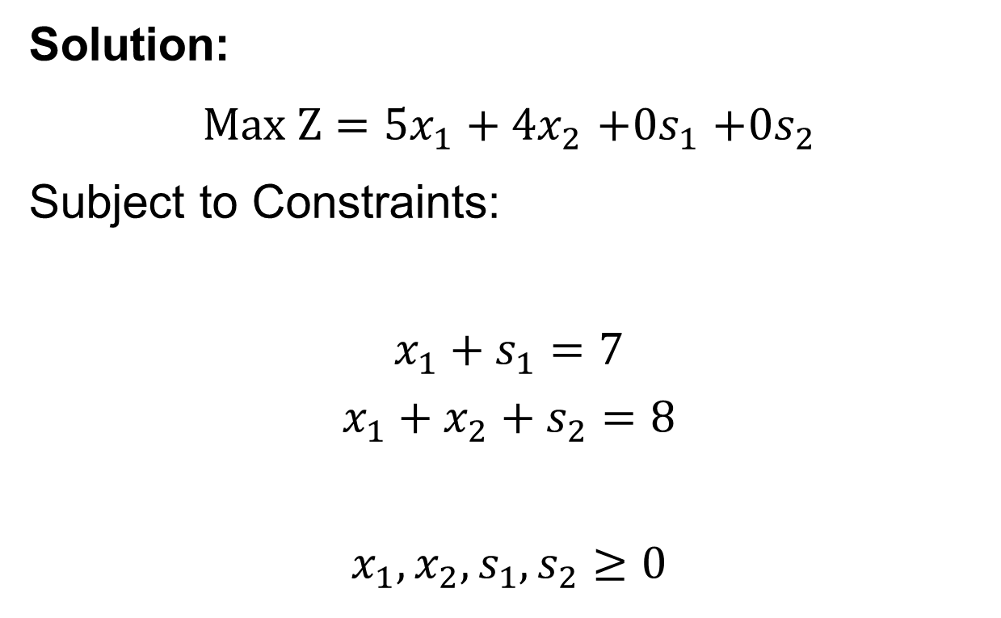
Simplex Method
Solution:
$Max Z=5x_{1}+4x_{2}$ $+0s_{1}$ $+0s_{2}$
Subject to Constraints:
$$x_{1}+s_{1}=7$$
$$x_{1}+x_{2}+s_{2}=8$$
$$x_{1},x_{2},s_{1},s_{2}≥0$$

Slide 4
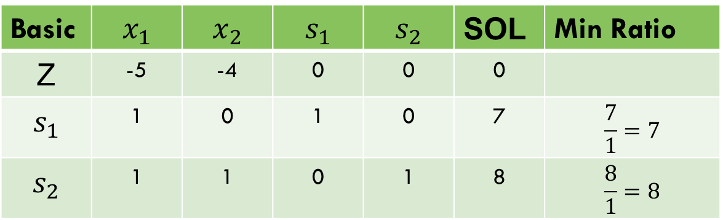

Simplex Method
$Z−5x_{1}−4x_{2}$ $−$ $0s_{1}−0s_{2}=0$
Basic | $$x_{1}$$ | $$x_{2}$$ | $$s_{1}$$ | $$s_{2}$$ | SOL | Min Ratio
Z | -5 | -4 | 0 | 0 | 0
$$s_{1}$$ | 1 | 0 | 1 | 0 | 7 | $$\frac{7}{1}=7$$
$$s_{2}$$ | 1 | 1 | 0 | 1 | 8 | $$\frac{8}{1}=8$$

Slide 5
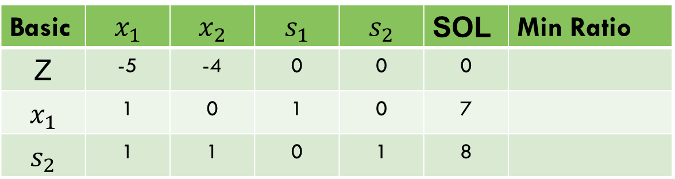
Simplex Method
Entering variable = Less negative value in z-row
Leaving variable = Minimum +ve ratio value
Basic | $$x_{1}$$ | $$x_{2}$$ | $$s_{1}$$ | $$s_{2}$$ | SOL | Min Ratio
Z | -5 | -4 | 0 | 0 | 0
$$x_{1}$$ | 1 | 0 | 1 | 0 | 7
$$s_{2}$$ | 1 | 1 | 0 | 1 | 8

Slide 6
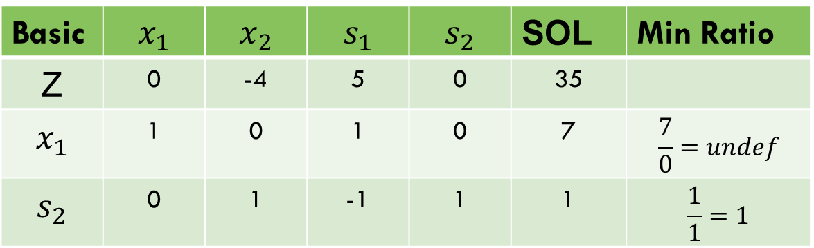
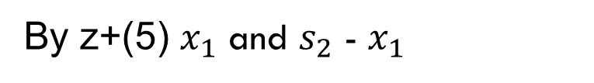
Simplex method
By z+(5) $x_{1}$ and $s_{2}$ - $x_{1}$
Basic | $$x_{1}$$ | $$x_{2}$$ | $$s_{1}$$ | $$s_{2}$$ | SOL | Min Ratio
Z | 0 | -4 | 5 | 0 | 35
$$x_{1}$$ | 1 | 0 | 1 | 0 | 7 | $$\frac{7}{0}=undef$$
$$s_{2}$$ | 0 | 1 | -1 | 1 | 1 | $$\frac{1}{1}=1$$

Slide 7
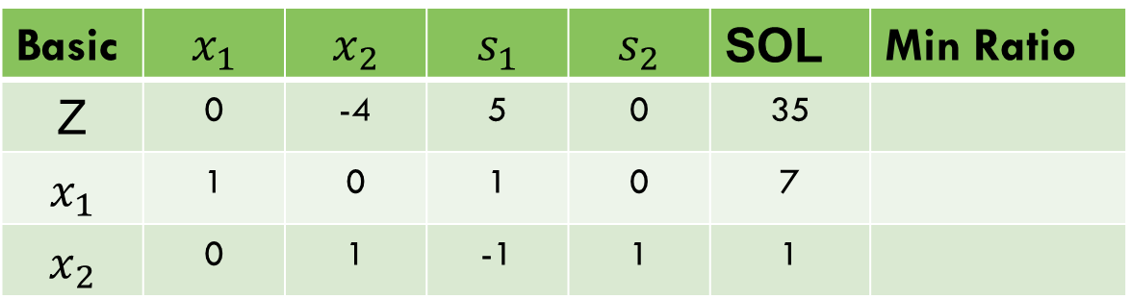

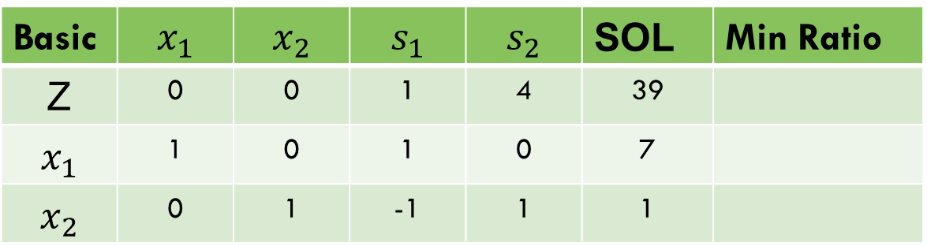
Simplex method
Basic | $$x_{1}$$ | $$x_{2}$$ | $$s_{1}$$ | $$s_{2}$$ | SOL | Min Ratio
Z | 0 | -4 | 5 | 0 | 35
$$x_{1}$$ | 1 | 0 | 1 | 0 | 7
$$x_{2}$$ | 0 | 1 | -1 | 1 | 1
By z+(4) $x_{2}$
Basic | $$x_{1}$$ | $$x_{2}$$ | $$s_{1}$$ | $$s_{2}$$ | SOL | Min Ratio
Z | 0 | 0 | 1 | 4 | 39
$$x_{1}$$ | 1 | 0 | 1 | 0 | 7
$$x_{2}$$ | 0 | 1 | -1 | 1 | 1

Slide 8
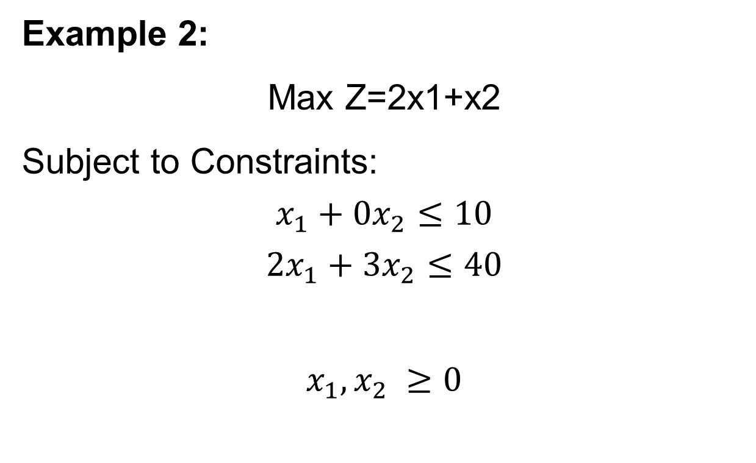
task
Example 2:
Max Z=2x1+x2
Subject to Constraints:
$$x_{1}+0x_{2}≤10$$
$$2x_{1}+3x_{2}≤40$$
$$x_{1},x_{2} ≥0$$

Slide 9

Infeasible solution
Example 1:
Max Z=3x1+2x2
Subject to Constraints:
$$x_{1}+x_{2}≤4$$
$$2x_{1}+x_{2}≥10$$
$$x_{1},x_{2} ≥0$$

Slide 10

Infeasible solution
$Max Z=3x_{1}+2x_{2}$ $+0s_{1}$ $+0s_{2}$
Subject to Constraints:
$$x_{1}+x_{2}+s_{1}=4$$
$$2x_{1}+x_{2}−s_{2}=10$$
$$x_{1},x_{2},s_{1},s_{2}≥0$$

Slide 11
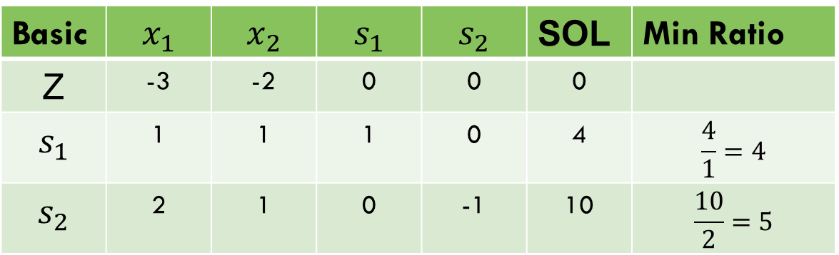

Infeasible solution
$Z−3x_{1}−2x_{2}$ $−$ $0s_{1}−0s_{2}=0$
Basic | $$x_{1}$$ | $$x_{2}$$ | $$s_{1}$$ | $$s_{2}$$ | SOL | Min Ratio
Z | -3 | -2 | 0 | 0 | 0
$$s_{1}$$ | 1 | 1 | 1 | 0 | 4 | $$\frac{4}{1}=4$$
$$s_{2}$$ | 2 | 1 | 0 | -1 | 10 | $$\frac{10}{2}=5$$

Slide 12
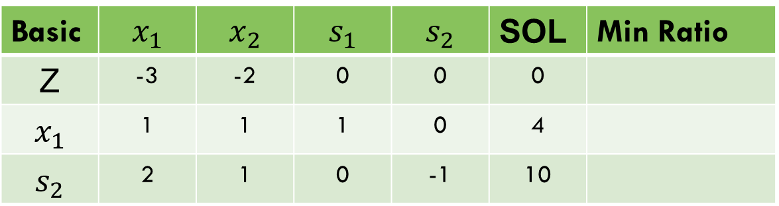
Infeasible solution
Entering variable = Less negative value in z-row
Leaving variable = Minimum +ve ratio value
Basic | $$x_{1}$$ | $$x_{2}$$ | $$s_{1}$$ | $$s_{2}$$ | SOL | Min Ratio
Z | -3 | -2 | 0 | 0 | 0
$$x_{1}$$ | 1 | 1 | 1 | 0 | 4
$$s_{2}$$ | 2 | 1 | 0 | -1 | 10

Slide 13
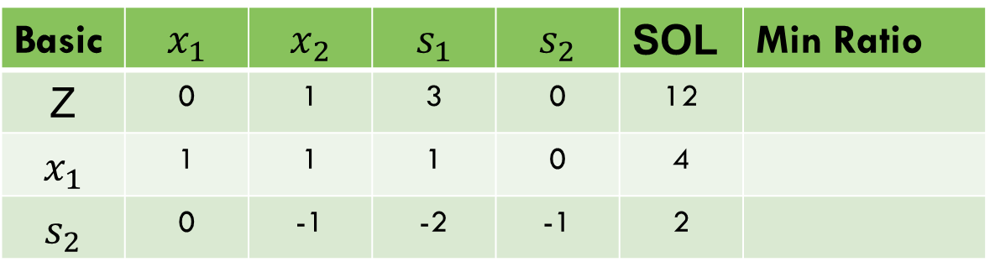
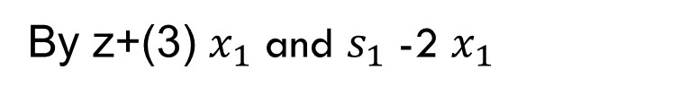
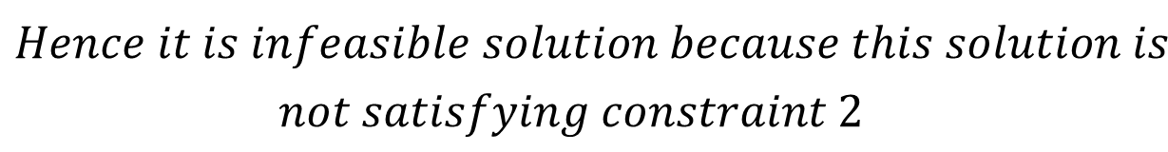
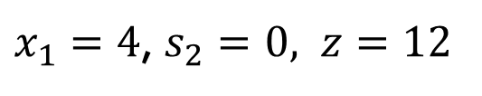
Infeasible solution
By z+(3) $x_{1}$ and $s_{1}$ -2 $x_{1}$
Basic | $$x_{1}$$ | $$x_{2}$$ | $$s_{1}$$ | $$s_{2}$$ | SOL | Min Ratio
Z | 0 | 1 | 3 | 0 | 12
$$x_{1}$$ | 1 | 1 | 1 | 0 | 4
$$s_{2}$$ | 0 | -1 | -2 | -1 | 2
$$All the values in the z rows is non negative,$$
$x_{1}=4$, $s_{2}=0, z=12$
$$Hence it is infeasible solution because this solution is$$
$$not satisfying constraint 2$$

Slide 14

task
Example 2:
$$Max Z=3x_{1}+2x_{2}$$
Subject to Constraints:
$${2x}_{1}+x_{2}≤2$$
$$3x_{1}+{4x}_{2}≥12$$

Slide 15
degeneracy
In some cases, there may be doubt in selecting the variables that should be introduced into the basic i.e. there is a tie between the ratio of two variables in the minimum ratio section, such cases are called as Degeneracy.

Slide 16

degeneracy
Example 1 :
Max Z= $2x_{1}+x_{2}$
Subject to Constraints:
$${4x}_{1}+3x_{2}≤12$$
$${3x}_{1}+x_{2}≤9$$
$$x_{1},x_{2} ≥0$$

Slide 17
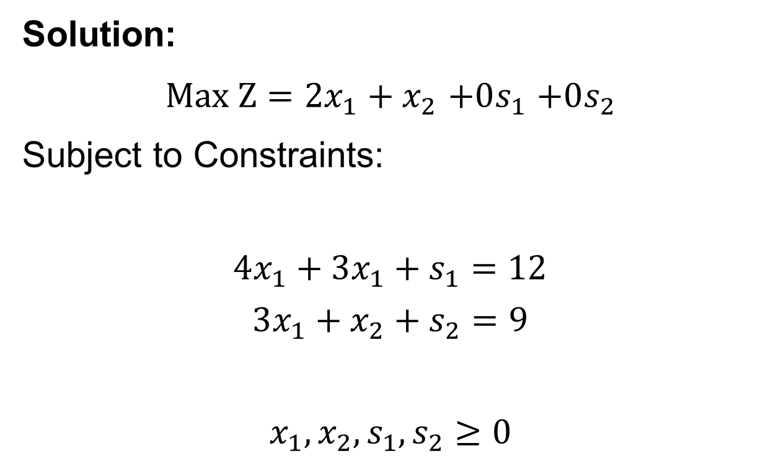
degeneracy
Solution:
$Max Z=2x_{1}+x_{2}$ $+0s_{1}$ $+0s_{2}$
Subject to Constraints:
$$4x_{1}+3x_{1}+s_{1}=12$$
$$3x_{1}+x_{2}+s_{2}=9$$
$$x_{1},x_{2},s_{1},s_{2}≥0$$

Slide 18
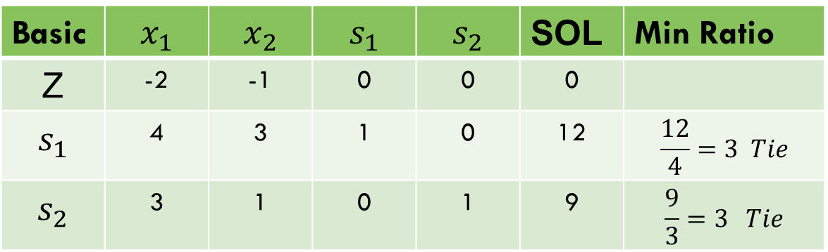

degeneracy
$Z−2x_{1}−x_{2}$ $−$ $0s_{1}−0s_{2}=0$
Basic | $$x_{1}$$ | $$x_{2}$$ | $$s_{1}$$ | $$s_{2}$$ | SOL | Min Ratio
Z | -2 | -1 | 0 | 0 | 0
$$s_{1}$$ | 4 | 3 | 1 | 0 | 12 | $$\frac{12}{4}=3 Tie$$
$$s_{2}$$ | 3 | 1 | 0 | 1 | 9 | $$\frac{9}{3}=3 Tie$$

Slide 19
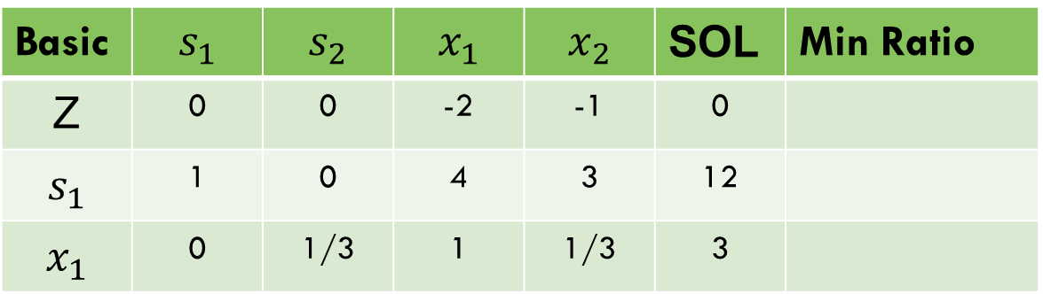
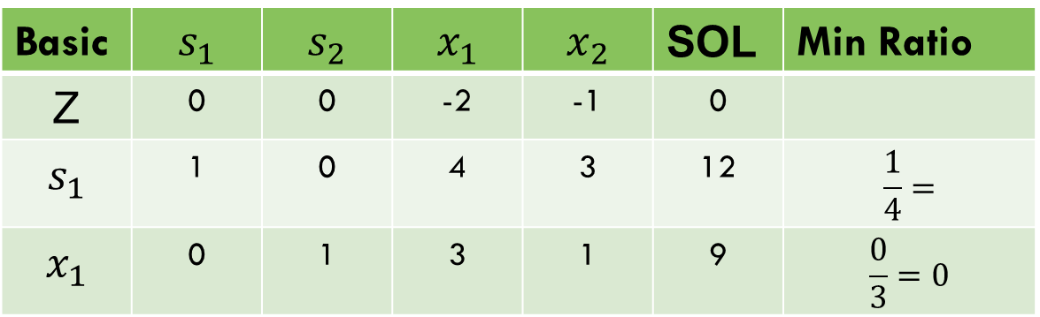

degeneracy
Basic | $$s_{1}$$ | $$s_{2}$$ | $$x_{1}$$ | $$x_{2}$$ | SOL | Min Ratio
Z | 0 | 0 | -2 | -1 | 0
$$s_{1}$$ | 1 | 0 | 4 | 3 | 12 | $$\frac{1}{4}=$$
$$x_{1}$$ | 0 | 1 | 3 | 1 | 9 | $$\frac{0}{3}=0$$
By $\frac{1}{3}x_{1}$
Basic | $$s_{1}$$ | $$s_{2}$$ | $$x_{1}$$ | $$x_{2}$$ | SOL | Min Ratio
Z | 0 | 0 | -2 | -1 | 0
$$s_{1}$$ | 1 | 0 | 4 | 3 | 12
$$x_{1}$$ | 0 | 1/3 | 1 | 1/3 | 3

Slide 20
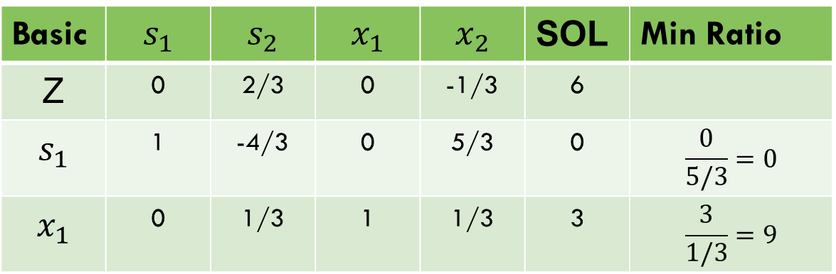
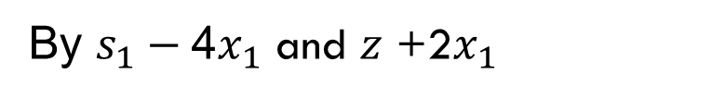
degeneracy
By $s_{1}−$4$x_{1}$ and $z$ +2$x_{1}$
Basic | $$s_{1}$$ | $$s_{2}$$ | $$x_{1}$$ | $$x_{2}$$ | SOL | Min Ratio
Z | 0 | 2/3 | 0 | -1/3 | 6
$$s_{1}$$ | 1 | -4/3 | 0 | 5/3 | 0 | $$\frac{0}{5/3}=0$$
$$x_{1}$$ | 0 | 1/3 | 1 | 1/3 | 3 | $$\frac{3}{1/3}=9$$

Slide 21
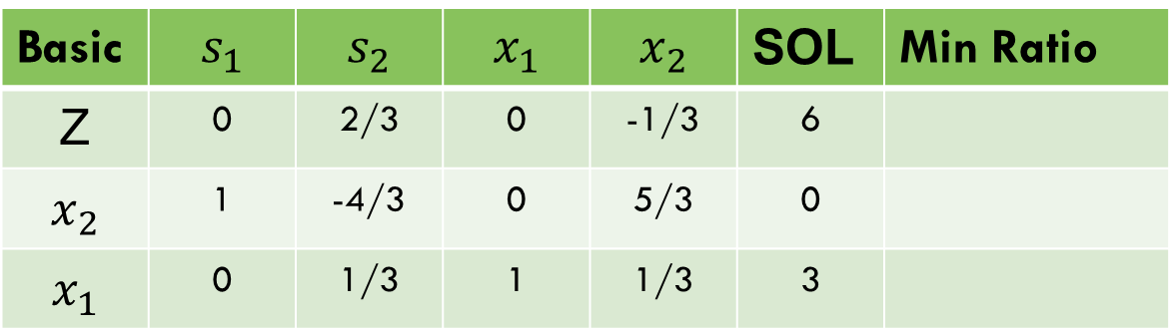

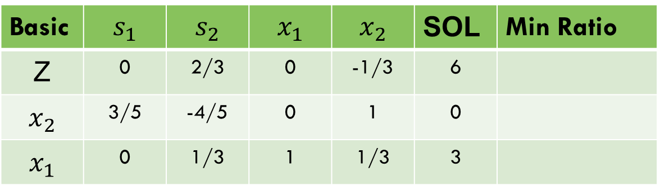
degeneracy
Basic | $$s_{1}$$ | $$s_{2}$$ | $$x_{1}$$ | $$x_{2}$$ | SOL | Min Ratio
Z | 0 | 2/3 | 0 | -1/3 | 6
$$x_{2}$$ | 1 | -4/3 | 0 | 5/3 | 0
$$x_{1}$$ | 0 | 1/3 | 1 | 1/3 | 3
By ${\frac{3}{5}x}_{2}$
Basic | $$s_{1}$$ | $$s_{2}$$ | $$x_{1}$$ | $$x_{2}$$ | SOL | Min Ratio
Z | 0 | 2/3 | 0 | -1/3 | 6
$$x_{2}$$ | 3/5 | -4/5 | 0 | 1 | 0
$$x_{1}$$ | 0 | 1/3 | 1 | 1/3 | 3

Slide 22
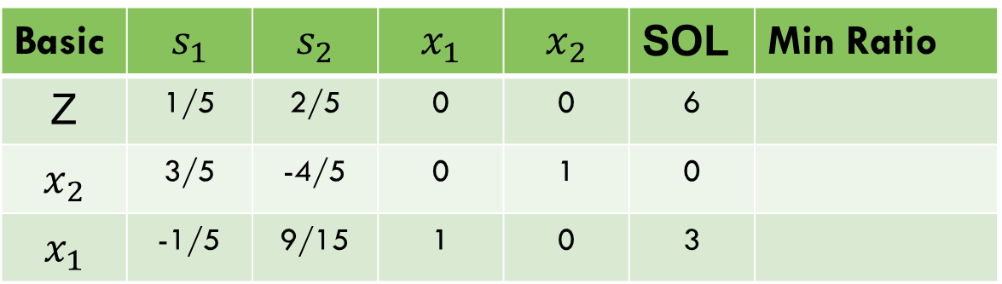

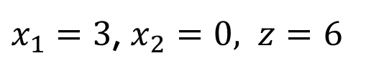
degeneracy
By $x_{1}− {\frac{1}{3}x}_{2}$, z$+{\frac{1}{3}x}_{2}$
Basic | $$s_{1}$$ | $$s_{2}$$ | $$x_{1}$$ | $$x_{2}$$ | SOL | Min Ratio
Z | 1/5 | 2/5 | 0 | 0 | 6
$$x_{2}$$ | 3/5 | -4/5 | 0 | 1 | 0
$$x_{1}$$ | -1/5 | 9/15 | 1 | 0 | 3
$x_{1}=3$, $x_{2}=0, z=6$

Slide 23

task
Example 2:
Max Z=3x1+9x2
Subject to Constraints:
$$x_{1}+4x_{2}≤8$$
$$x_{1}+2x_{2}≤4$$
$$x_{1},x_{2} ≥0$$

Slide 24
Thank you!

